Slide 1
YikeSite 2.0
Team #7 for Animikii

Slide 2
Team Introduction
Gulshan Lalari - Web Developer
Hannah Bishop - Marketing Manager
Darian Sampare - UI Designer
Jacob Jones - Interface Designer
Ceilidh Torrance - Systems Analyst
Ryan Woodward - Systems Analyst

Slide 3
Project Overview
Why the project is being done?
The YikeSite CMS is severely outdated causing issues for Developers, Clients and the Animikii Management team.
What problems need to be addressed?
Developers are currently working without the use of common features found in modern web development.
The client editing process lacks a user friendly in-browser editing function, causing management to be tied up with troubleshooting problems and client dissatisfaction.
Proposed Solution?
Creation of YikeSite2.0 using an Object Oriented Modular System.
Notes:
Animikii is an Indigenous digital agency that employs an expert team who work across various digital spaces such as Software development, Design, Digital communications and most importantly Web Development, which is the focus of our project. Animikii creates websites for their large client base by using a web content management system called YikeSite, which was created by their team of Web developers in the early 2000’s. This system is currently enduring problems due to its lack of updates over the last 15 years. Problems are occurring when the Development team are building a website for a client but don’t have access to common web development features that would normally aid them in meeting the needs of their client. This makes the development process more time consuming than it needs to be. Once the websites are built and are in the hands of the clients, some clients are having difficulty editing their web pages as some changes must be made inside an admin portal which can be too complex for clients to use and end up leading to more problems in the end. Our proposed solution is to create a YikeSite2.0 CMS that uses a Modular Object Oriented approach to address these problems and make things easier for everybody.

Slide 4

Animikii Introduction
Indigenous digital technology agency
Offers services to the indigenous communities in Canada and the US in creating development, graphic design, and digital marketing
Started in 2003 by Jeff Ward
Content management system YikeSite was created in 2004
YikeSite allows companies to independently maintain their websites
Company has expanded over the past few years from 4 to 11 members and continuing to grow

Slide 5
YikeSite Statement of Purpose
In-browser content management system for websites
Makes website creation and upkeep easier
Provides features for both developers and non-technical users

Slide 6
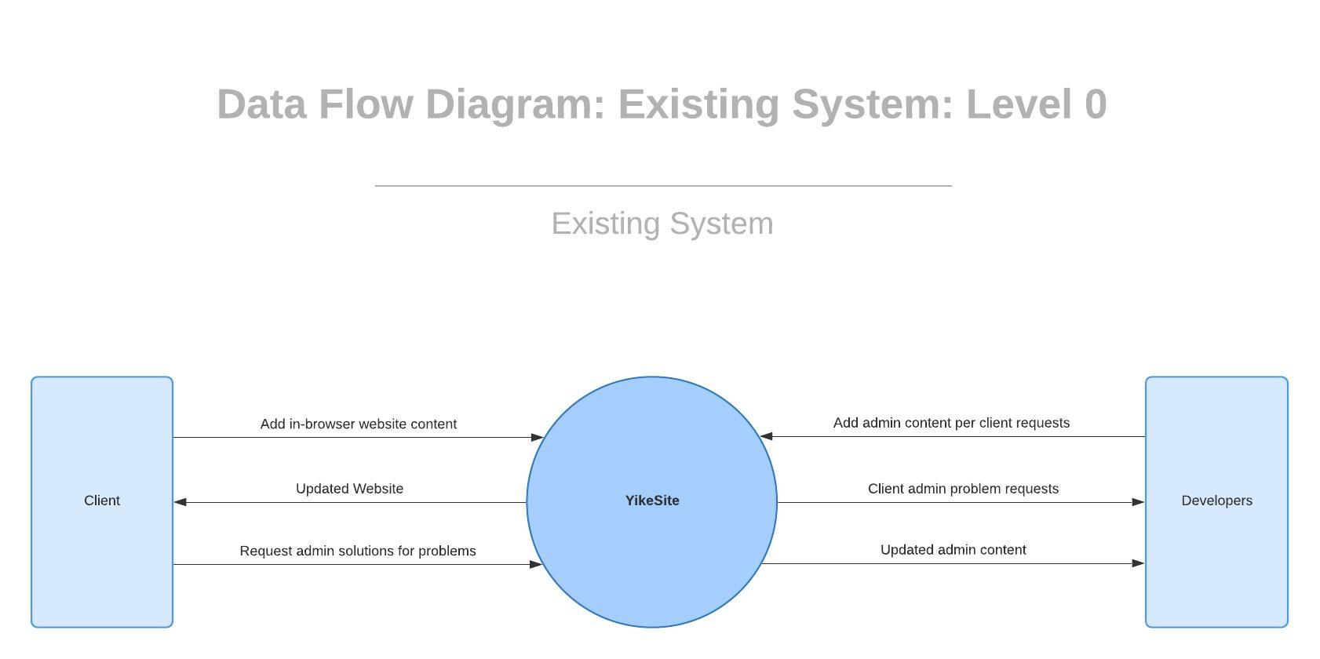
Current System: YikeSite
Used by developers to make structural/layout changes
Content uploaded and edited by administrative staff and clients
Has simple WYSIWYG interface with dated tools, allows for basic website development and upkeep
Lacking in modern features and usability

Slide 7



Proposed System - Ryan
An object oriented modular system would address the key issues that have been brought forth by Animikii Stakeholders
CLIENTS
DEVELOPERS
CEO
Notes:
We proposed to Animikii an object oriented modular system and found positive response. It would address the needs of the clients, developers, and the CEO

Slide 8
YikeSite 2.0
The system that we propose would transition from the WYSIWYG model of website design into object oriented models.
Clients will be able to edit object frames in their site dynamically
Content frames will be classified as modules. Each module can have it’s own unique set of tools. Similar to objects.
Modular page design allows for reusable objects
Modular page design allows the separation of data from code
Notes:
The system that we propose would transition from the WYSIWYG (what you see if what you get) model of website design into an object oriented one. Clients will now be able to edit object frames in their site dynamically. Now

Slide 9
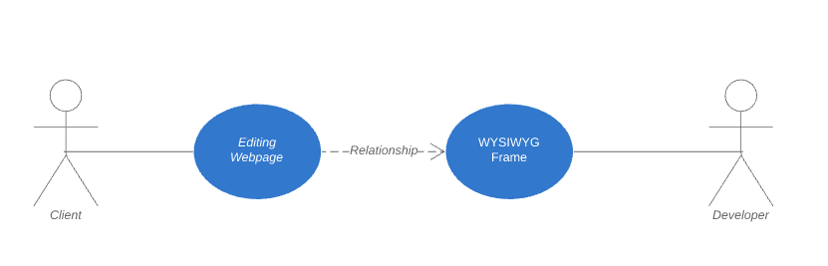
YikeSite 2.0
At the time a simplistic use case model was all that was needed given the state of webpages.
Notes:
The current system has a very simplistic model. A user simply has to click on edit for the wysiwyg frame in the webpage. Edit the page. And then hit save.

Slide 10
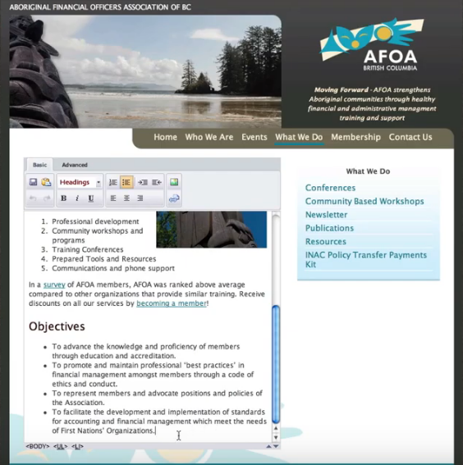
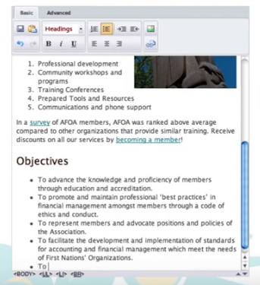
YikeSite 2.0
These images give us a view of what a client is able to edit within a site.
Notes:
The current system has a very simplistic model. A user simply has to click on edit for the frame. We see within the red text box that this is the only editable frame for the client. Once inside the frame they are presented with very primitive tools to be able to edit their content. These resemble those of a word processor. I’ll pass off to Darian so he can show you an example of what user’s can expect with YikeSITE 2.0

Slide 11
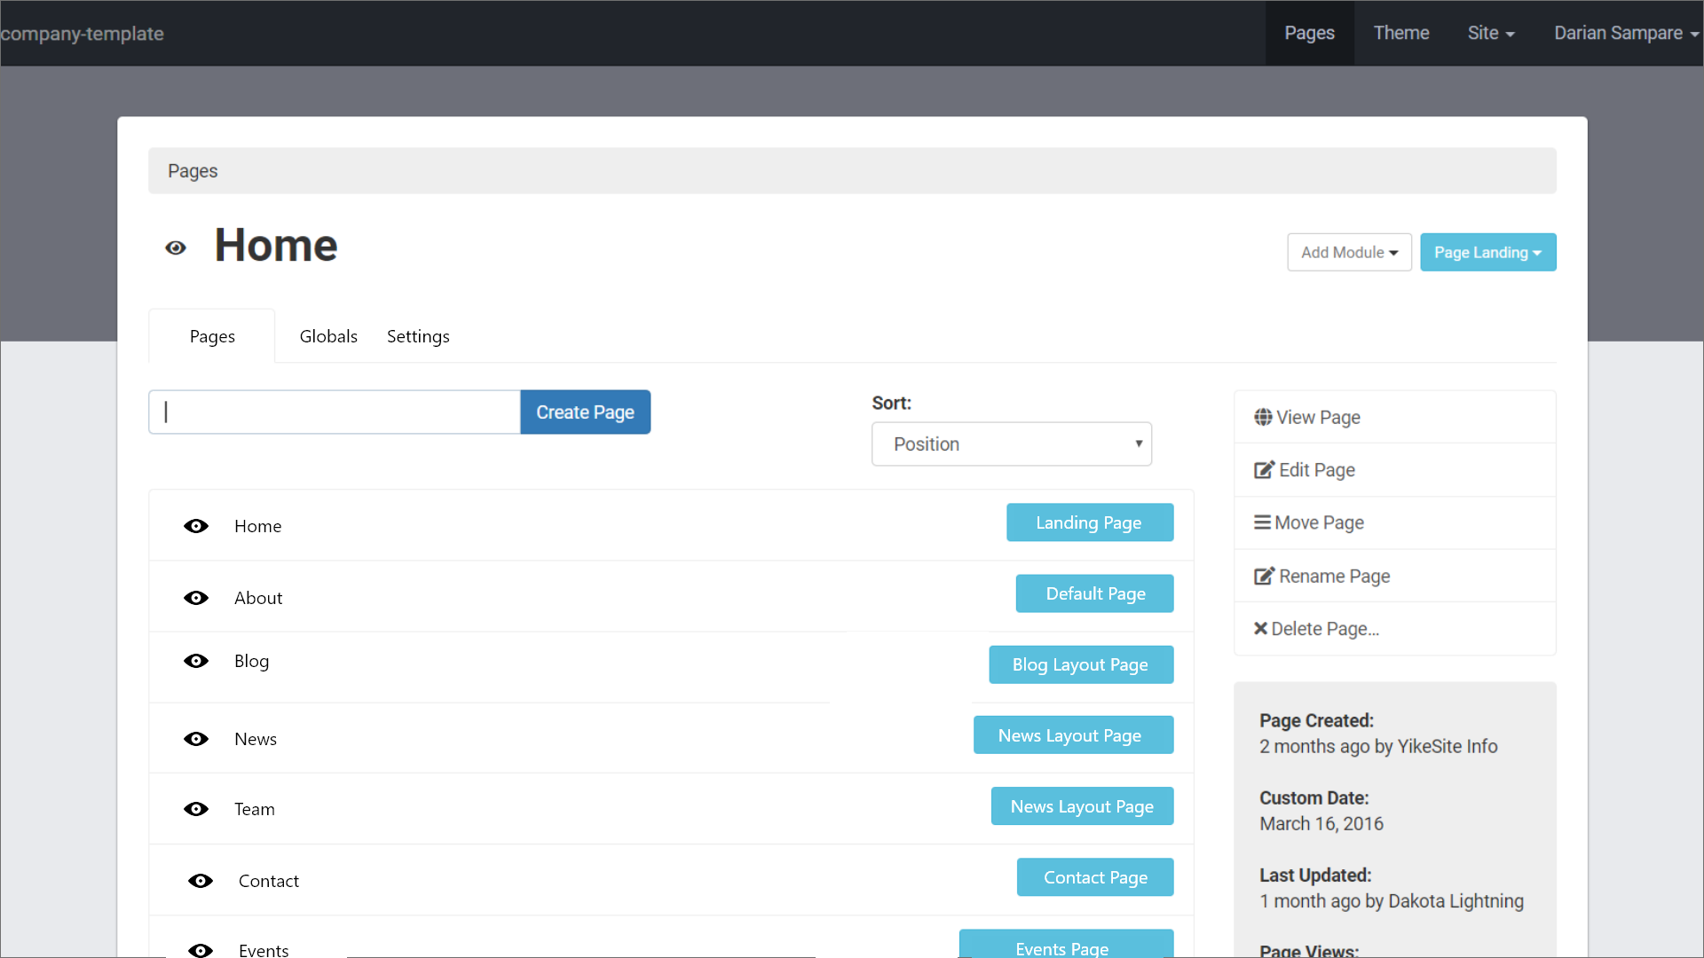
YikeSite 2.0
Revamped Home Page Structure
Site sections are concise and easy to find
Cascading pages can be sorted easily
Easy to pick and edit a page
Notes:
The system that we propose would transition from the WYSIWYG (what you see if what you get) model of website design into an object oriented one. This is the main home page structure that gives a much better view of how each page is organized.

Slide 12
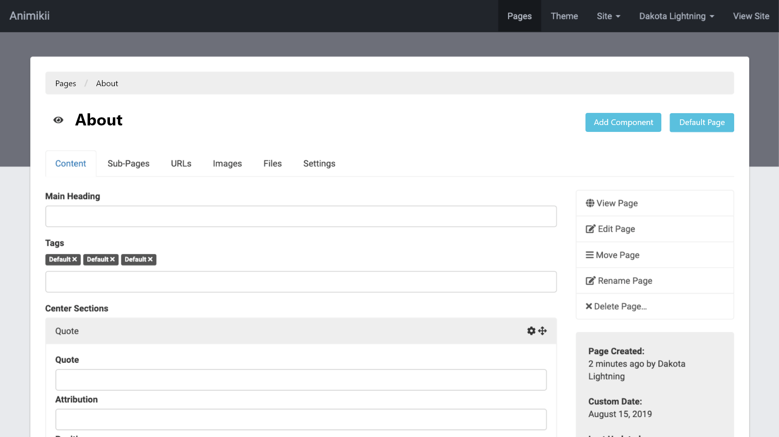
YikeSite 2.0
Yikesite 2.0 offers a structured inner page model that offer client’s more tools at their disposal to add content.
Notes:
Darian’s page - pass to Ryan for 13

Slide 13
YikeSite 2.0
What if a customer wants more editable areas on their page?
Notes:
We introduce the inner editing page model. In this state we can see that the client will have many more options in order to add content to their site. Gone is the word processor. Instead we offer modularized content. This will allow the client to add much more content to their page then before.

Slide 14
YikeSite 2.0
What if a customer wants more editable areas on their page?
They must ask a developer to insert those WYSIWYG editable frames.
Notes:
In the existing system a customer would have to ask the developer each time they wanted an editable area to be put on the page. Henceforth this would make any modifications to the website very labour intensive for the developers.

Slide 15
YikeSite 2.0
What if a customer wants more editable areas on their page?
YikeSite 2.0 now allows components to be premade in modules
Notes:
In our proposed system the client has access to modules. These are reusable components that can be added to any webpage at any time.

Slide 16
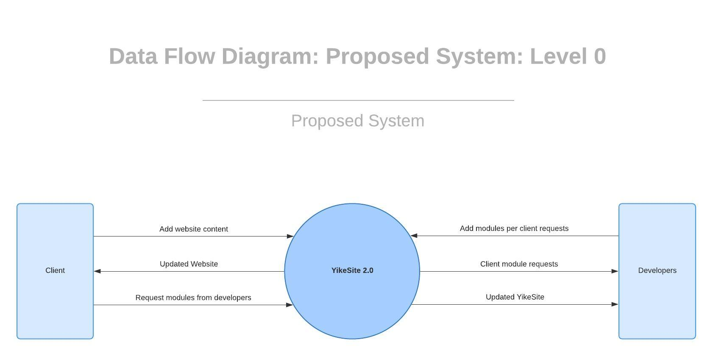
YikeSite 2.0
Notes:
We can see that these modules only make a slight change to the DFD diagram that the original system proposed. Whereas before the client would request the admin of the site for solutions to their problems, now they only have to request new modules.

Slide 17
Existing YikeSite
WHAT HAPPENS TO CONTENT WHEN AN AREA GETS EDITED?
Notes:
So what would happen to the content after an editable frame was edited by customer? Pass to Darian

Slide 18
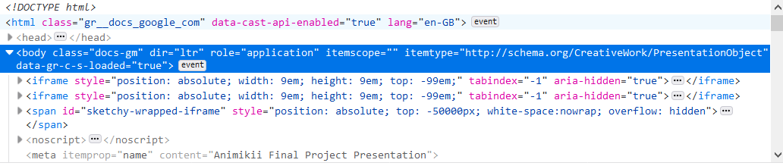
Existing YikeSite
EDITED CONTENT BECOMES EMBEDDED IN THE CODE
Notes:
The edited content would be added to the HTML code. This poses a rather large problem for the developers. Everytime a WYSIWYG window was edited, the data would become mixed with the HTML code. Therefore once again if a client requested new functionality, the developers would have to develop from scratch.

Slide 19
YikeSite 2.0
Content becomes a part of the module.
Data of module can be exported and reused
Data can be accessed as you would access the instance variables of an object
Notes:
With YikeSite 2.0 the data would become part of that instance of the module. This solves several issues. Such as allowing the data to exported to other areas of the site. It would allow data to be accessed similar to that of instance variables of an object. And it could allow data to be exported off the website to other formats.

Slide 20
Problems Solved by YikeSite 2.0
Easier updates and maintenance
User friendly
Supports common features

Slide 21
Risks Associated with YikeSite 2.0
Risk | Possible Loss (Loss likelihood) | Mitigation Method
Clients not wanting to learn a new system/learning curve for existing clients | Client productivity (Medium) Clients (Low) | Additional training for existing clients
Developers adjusting to new system | Developer productivity (Medium) | Allowing developers time to get used to the system before launch
Developers putting too much attention on YikeSite 2.0 and not enough on clients or vice versa | Client dissatisfaction (Low) Longer development times (Medium) | - Create a work schedule that specifies time to spend on each - Re-evaluate regularly to determine if schedule needs to be changed

Slide 22
Cost Analysis For Potential Solutions
Moving to another established CMS system
Will need to reconstruct websites of 200+ clients on a new CMS or continue supporting current clients on the old system
Probable loss of licensees as additions to YikeSite will come to a halt
Complete rebuild
Development time for a complete rebuild of the system was estimated at 8-12 months with 3-4 full-time developers working on the project
Significant re-write of the YikeSite 1.0
Resources required will be significantly less, 2-3 developers while maintaining other client work as well over the course of 6-8 months
Potential risk of the new system still not meeting expectations of developers

Slide 23
Benefit Analysis for Potential Solutions
Moving to another established CMS system
Requires less resources from development team up front
Will significantly speed up development time on new projects
No time spent on reconstructing the YikeSite CMS or future additions of features
Complete rebuild
Total control over projects from a development perspective
Ease of use for clients
Possibility to increase sales to licensees
Significant re-write of the YikeSite 1.0 System
Keep what works, focus on pain points for clients and development team
Improve usability for the client in a familiar system
Give developers better tools by implementing the features possible in current architecture
Notes:
Moving to another CMS would require less resources from development team initially, but reconstructing the websites of 200+ clients on another CMS is not feasible. Those existing clients would still require maintenance of their site in the YikeSite CMS as well as maintenance to the engine
Not enough resources, current client pushback, time to migrate existing sites yet again
Can focus on pain points and continue using what works, editability will be easier for the client but the system will be familiar, developers will have better tools to do their jobs

Slide 24
Recommendation
Stay with existing system instead of moving clients to similar CMS
Give clients updates before development occurs
Continue working with clients to make sure YikeSite2.0 fulfills needs
Slowly make changes to the current Yikesite with clear instructions on how to use the new system
Notes:
Group together: Recommendation + conclusion

Slide 25
Conclusion
Research early for foothold in marketplace
Ask clients for all applicable information
Maintain frequent communications with stakeholders and clients
Clearly define goals and when they are to be completed by
Notes:
Group together: Recommendation and conclusion

Slide 26

Thanks to Animikii
Thank you Jeff Ward and Animikii for your involvement and support

Slide 27
Questions?

